Slide 1

Machine Learning: Introductory Concepts

Slide 2

Agenda
What is Machine Learning (ML)?
ML Workflow
Key Concepts
Sci-Kit Learn and Yellowbrick
  Developing your first estimator

Slide 3
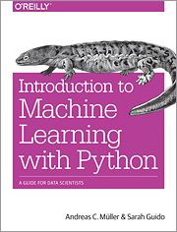
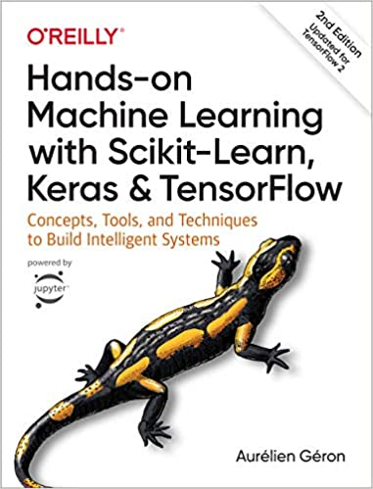
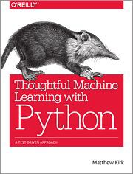
Recommended Reading
Introduction to Machine Learning with Python by A. Muller and S. Guido
(O’Reilly 2016)
Hands-On Machine Learning 2e by Aurelien Geron (O’Reilly, 2019)
Thoughtful Machine Learning with Python by M. Kirk (O’Reilly 2016)

Slide 4
What is Machine Learning?

Slide 5
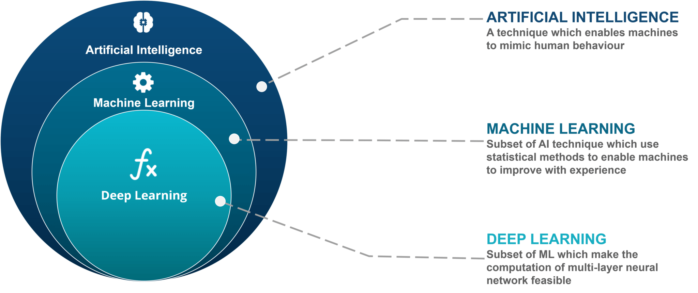
Defining Machine Learning
AI vs Machine Learning vs Deep Learning
Source: https://www.edureka.co/blog/ai-vs-machine-learning-vs-deep-learning/

Slide 6




What is Machine Learning?
Defining Machine Learning
Machine Learning is the science of getting computers to identify pertinent patterns within various data structures to provide augmented insight through prediction. At its core, Machine Learning is a field at the intersection of statistics, computer science, and artificial intelligence and is often referred to as predictive analytics.
ML Design Characteristics
Everyday Applications of Machine Learning
Identifies patterns in historical data through statistical methods
Quantify record variation based on provided inputs
Makes recommendations through prediction (Regression, Classification)
By quantifying a pattern from sample inputs, the machine learning algorithm predicts and performs tasks based on the learned pattern and is not limited to pre-programed instruction in a declarative computing design using historical examples and diverse features.
It is so pervasive today that its applications range from everyday uses like movie recommendations on Netflix to biomedical scanning and prediction for various pathology predictions.
Speech Recognition
Examples: Siri, Alexa, Cortana
Effective Web Search
Examples: Google, Bing, Baidu
Advanced Applications of Machine Learning
Human Genome Research
Self Driving Cars
Notes:
Tags: text, chevron, list, customer experience, CX

Slide 7
ML Workflow

Slide 8
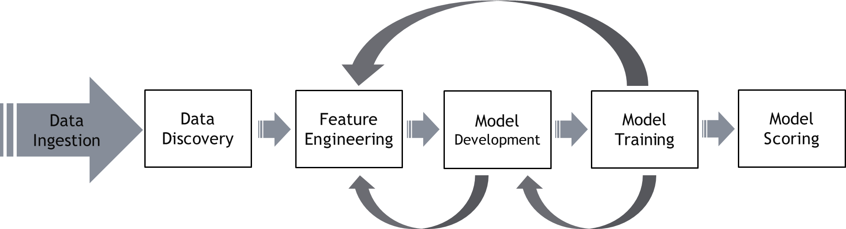
Machine Learning Development Lifecycle
MACHINE LEARNING INSIGHTS
Supervised Learning: The machine learning task of inferring a function from labeled training data; the training data consist of a set of training examples; in supervised learning, each example is a pair consisting of an input object (typically a vector) and a desired output value (commonly referred to as the label or target)
Unsupervised Learning: Unsupervised learning is a type of machine learning algorithm used to draw inferences from datasets consisting of input data without labeled responses; the most common unsupervised learning method is cluster analysis, which is used for exploratory data analysis to find hidden patterns or grouping in data
Machine Learning Lifecycle:
Model Deployment: Making model predictions easily available
Model Evaluation: Measuring quality of deployed models
Model Monitoring: Tracking model quality over time
Model Management: Improving deployed models with feedback
Notes:
Tags: text, chevron, list, customer experience, CX

Slide 9
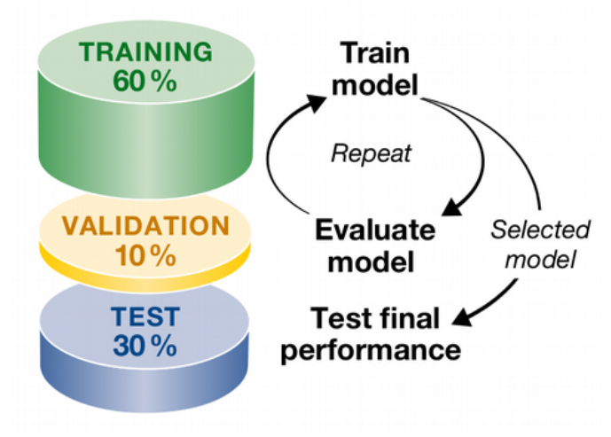
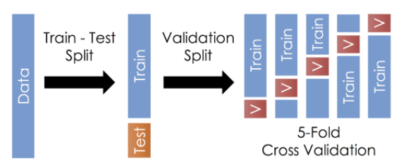
Model Training and Testing Deep Dive
MACHINE LEARNING INSIGHTS
Analogy: think about how you would prepare for an exam
Data Set
Notes:
Tags: text, chevron, list, customer experience, CX

Slide 10
Key Concepts

Slide 11
Instances, Features and Dimensions
Dimensions and Features
In order to perform a machine learning task, you need a data set containing instances (examples) that are comprised of features from which you compose dimensions.
Instance: a single data point or example composed of fields
Feature: a numeric quantity describing an instance
Dimension: one or more attributes that describe a property
from sklearn.datasets import load_iris
iris = load_iris()
X = iris.data
y = iris.target
# X.shape == (n_samples, n_features) # y.shape == (n_samples,)
Notes:
Tags: text, chevron, list, customer experience, CX

Slide 12
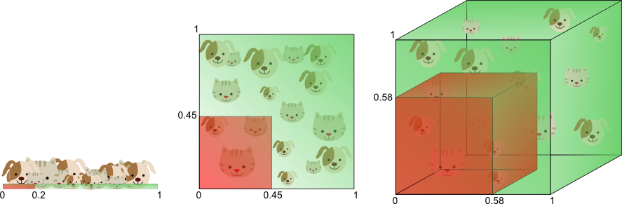
The Curse of Dimensionality and Dimensionality Reduction
Dimensions and Features
High dimensional data (i.e. data with tons of input features, sometimes more features than observations) is typically sparse and poses a unique set of problems for machine learning. Imagine we’re trying to identify, based on a hair length and ear length, if an observation is a dog or cat. As you consider more features like weight, hair color, and whisker length, the feature space for this data continues to grow and so to does the space between observations. Not only does this increase the computation process time, but it also increases the model complexity and risks overfitting. Additionally, models based on locality (like kNN) risk skewness from highly dimensional data.
Dimensionality Reduction is the transformation of data from a high dimensional space to a lower dimensional space, such that the low dimensional space maintains meaningful representation of the data. Solutions to dimensionality reduction are often divided into two approaches: Feature Selection and Feature Extraction. Feature selection aims to reduce redundant features from the dataset while retaining a subset of original features. Feature extraction (or feature projection) transforms data from a high dimensional space to a low dimensional space and often leads to feature engineering. We’ll touch more on feature extraction in the data pre-processing section
Notes:
Tags: text, chevron, list, customer experience, CX

Slide 13
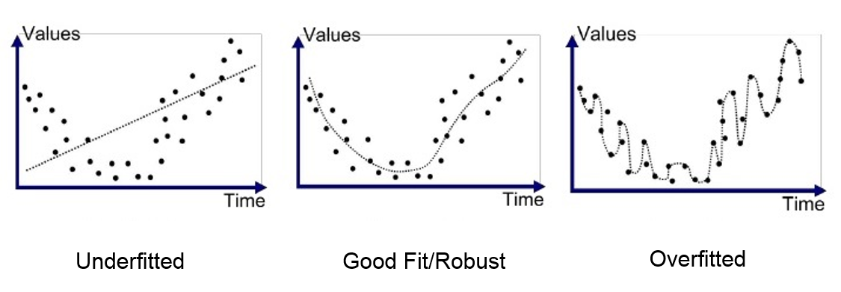
Generalization, Overfitting, and Underfitting
Dimensions and Features
The common goal of a supervised machine learning task is to build a model on training data that can make accurate predictions on new, unseen data with the same characteristics as the data we trained on. If a model is able to accurately predict on unseen data, it is able to generalize from a training dataset to a test dataset. Intuitively, we would expect simple models to generalize the best to new data. A complex model learns and fits too closely to the particulars of the training data and is referred to as overfitting. Inversely, a model too simple such that it doesn’t capture all the aspects of the data is prone to underfitting.
 | Training Score | Test Score
Underfitting | Low | Low
Good Fit/Robust | High | High
Overfitting | High | Low
Notes:
Tags: text, chevron, list, customer experience, CX

Slide 14
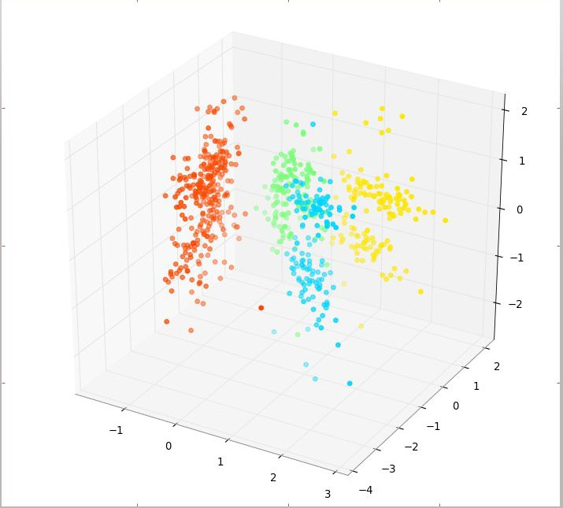
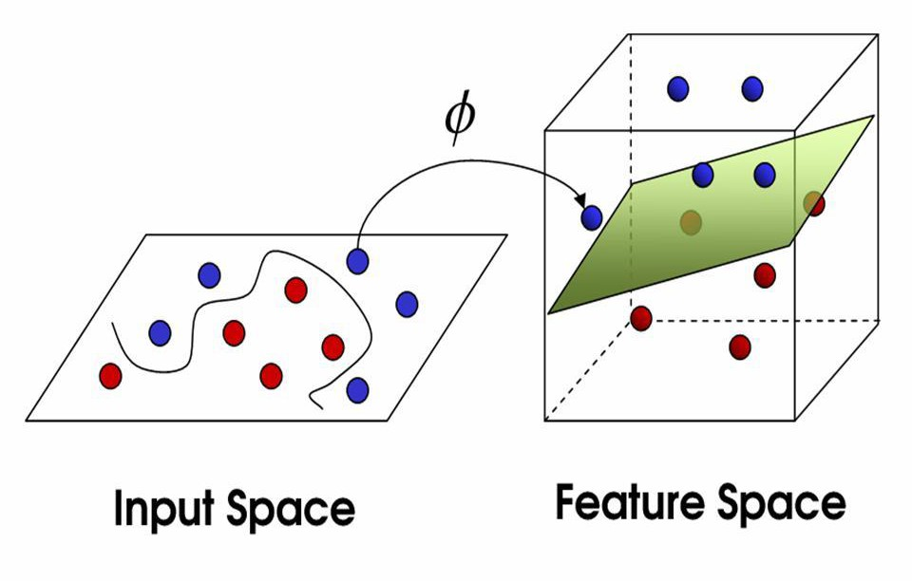
Feature Spaces, Mappings, and Feature Engineering
Dimensions and Features
Before diving into data pre-processing and how to implement it in sci-kit learn, here are a few concepts to be aware of
Feature Space
Mapping
Feature Engineering
Feature space refers to the n-dimensions occupied by your variables (not including a target variable or class). The term is frequently seen in ML literature because in ML all variables are features (usually) and feature extraction is the art of outlining a space with decision boundaries.
Target: Y = Classification of likelihood to buy a boat
Variables: X₁ = # of children, X₂ = Range of income, X₃ = # of cars owned
Feature Space: R³
Domain knowledge about boat marketing might suggest that the ratio of children to cars owned is important, hence we generate another variable, X₄ (this is feature extraction):
X₄ = X₁ / X₂ = # of children / # of cars owned
This extends our feature space from R³ to R⁴
A mapping is a function, ϕ, from R³ to R⁴:
ϕ(x₁,x₂,x₃) = (x₁,x₂,x₃,x₁x₂)
Feature engineering is the process of leveraging and transforming raw inputs into features that better depict the underlying problem to the predictive models, leading to improved model accuracy on unseen data
Machine learning features need to be relevant to the machine learning problem. Instead of using hundreds of low-relevance features, it is ideal in practice to select less features of a higher quality. These better features might result in longer computational time but if you’re using logic instead of statistics you will not have to compute every feature for each tested data point as your model is able to return its classification decision without relying on all features.
Notes:
Tags: text, chevron, list, customer experience, CX

Slide 15
SciKit-Learn

Slide 16

What is Sci-Kit Learn?
MACHINE LEARNING IN PYTHON
SciKit-Learn is the most prominent library for machine learning algorithms.
Algorithms for Supervised & Unsupervised learning
Built on SciPy and NumPy
Standard Python API interface
Primary Features:
Dataset Transformation
    Standardization
    Normalization and Scaling
    Encoding
    Imputation
    Feature Extraction
Pipelining
Generalized Linear Models, Support Vector Machines, k-Nearest Neighbors, Bayes, Decision Trees, and Ensembles
Model Evaluations and Cross Validation
Grid Search and Hyperparameter Tuning
Notes:
Tags: text, chevron, list, customer experience, CX

Slide 17
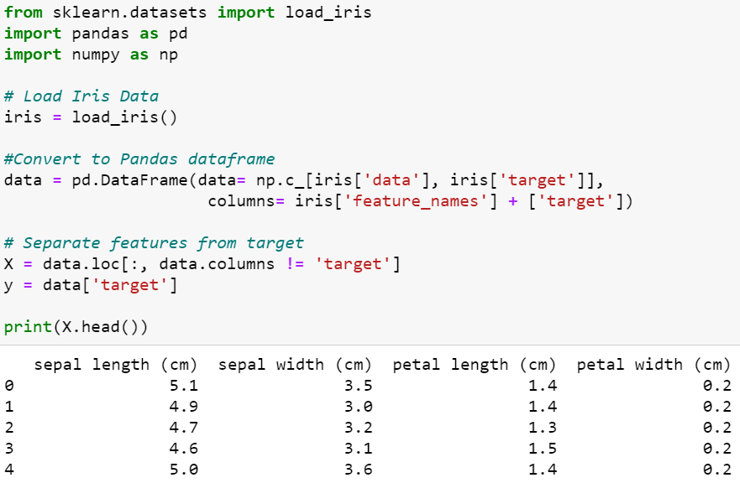
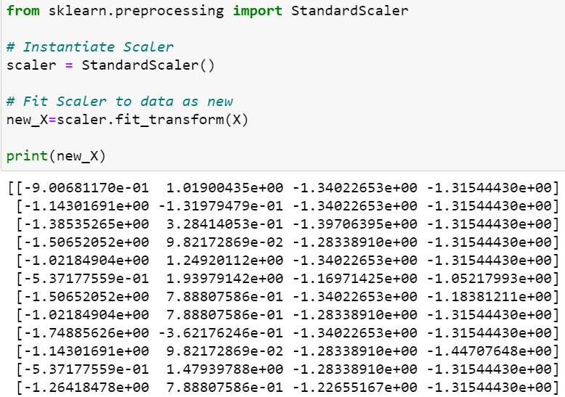
Dataset Transformations: Standardization
DATA PREPROCESSING INSIGHTS
Standardization is a scaling technique where values are transformed to center around a mean of 0 with a unit standard deviation. It is particularly helpful when the data follows a Gaussian (normal) distribution, but this isn’t a necessary requirement. Since standardization doesn’t have a bounding range, outliers are not affected by it.
Negative values will be less than the mean, while positive values will sit above it
Computed as (value – mean / standard deviation)
Objective functions in learning algorithms may expect a standard distribution (i.e. L1/L2 Regularization used in Ridge/Lasso Regression)
Features with a high magnitude of variance compared to others may dominate estimator, making it unable to learn from other features
Notes:
Tags: text, chevron, list, customer experience, CX

Slide 18
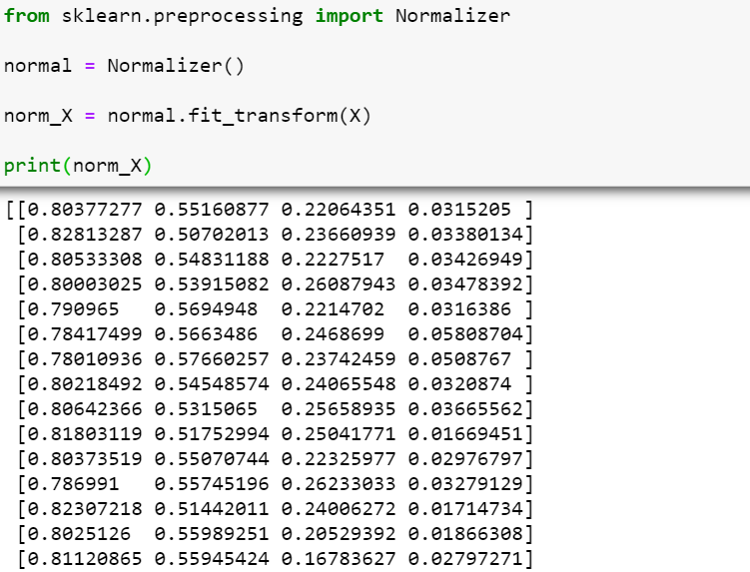
Dataset Transformations: Scaling and Normalization
DATA PREPROCESSING INSIGHTS
An alternative standardization is scaling features to lie between a given minimum and maximum value, often between zero and one. It provides robustness to very small standard deviations of features and preserving zero entries in sparse data.
Normalization is the process of scaling individual samples to have unit norm. This process can be useful if you plan to use a quadratic form such as the dot-product or any other kernel to quantify the similarity of any pair of samples. This assumption is the base of the Vector Space Model often used in text classification and clustering contexts.
Notes:
Tags: text, chevron, list, customer experience, CX

Slide 19
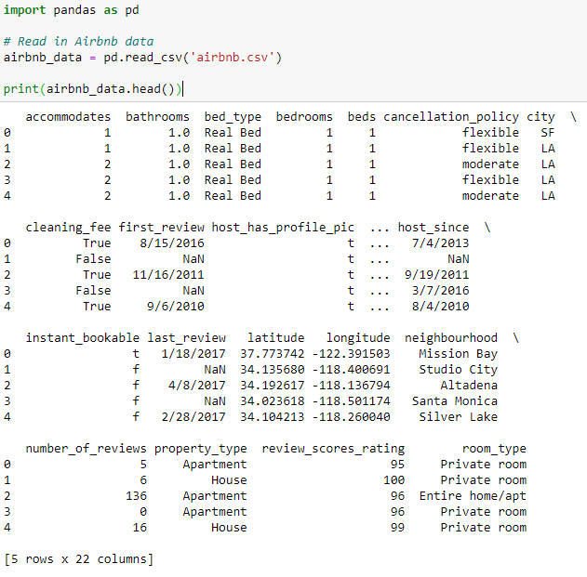
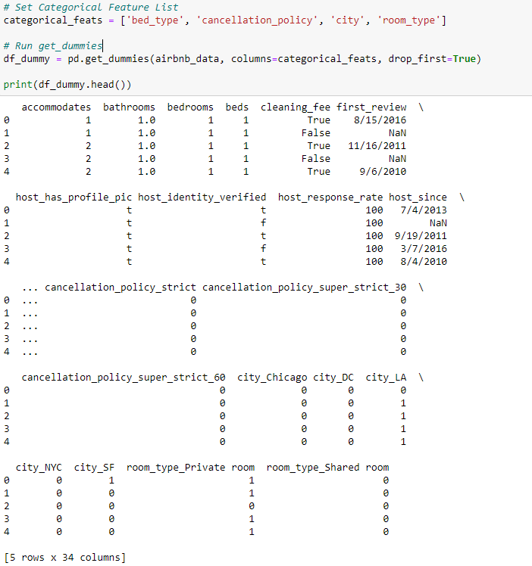
Dataset Transformations: Encoding
DATA PREPROCESSING INSIGHTS
In ML, encoding is an important preprocessing step for supervised learning with structured data. Two common types of encoding are Label Encoding and One-Hot Encoding.
Label Encoding is the process by which labels (i.e., text valued variables like “Apple” or “Banana”) are converted into numeric form so as to make them machine-readable. It is then easier to design the algorithm to operate on the labels.
One-Hot Encoding is the process by which categorical variables into new features with discrete values represented by binary inputs (0,1)
Notes:
Tags: text, chevron, list, customer experience, CX

Slide 20
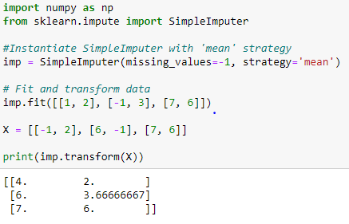
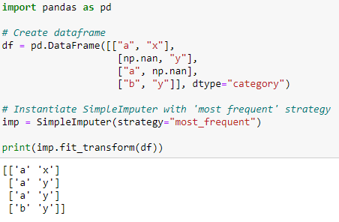
Dataset Transformations: Imputation
DATA PREPROCESSING INSIGHTS
As we learned with encoding, machine learning algorithms for the most part require numeric inputs, however, they also require a value to be present within each record in a dataset. In practice, data can often be missing values, an it is common to identify those features with missing values and impute the values. Imputation is the process of replacing missing data with substitute values. Commonly, the feature mean, median, mode, or a constant are used to fill in the missing values.
Notes:
Tags: text, chevron, list, customer experience, CX

Slide 21
Dataset Transformations: Feature Extraction
Dimensions and Features
Since feature selection at its core is centered around identifying the best subset of features, we’ll instead focus on feature extraction, which is a more complex process as its roots are grounded in transforming the data. Data transformations may be linear or nonlinear. A linear transformation implies that the transformation does no change the correlation among the variables. A nonlinear transformation is the counterpoint of this such changes the relationship of the variables. A few common examples of these types of transformations are described below.
Common Feature Extraction Methods
Principal Component Analysis (PCA):
The primary linear technique for feature extraction, PCA rotates the dataset in such a way that the features are statistically uncorrelated. The rotation is followed by selecting only a subset of the new features, according to how important they are for the data.
Non-Negative Matrix Factorization (NMF):
A nonlinear technique, NMF works similarly to PCA, however it requires features to be non-negative since the focus is on having components and coefficients greater than or equal to 0. This is particularly helpful for data combined from independent sources, such as audio tracks of multiple people speaking
Linear Discriminant Analysis (LDA):
A linear technique for classification, LDA attempts to express a categorical dependent variable (i.e. your target) with N number of continuous independent variables. Like PCA, LDA also searches for linear combinations of variables that best explain the data. The difference being LDA attempts to model the differences between classes. ‘
Notes:
Tags: text, chevron, list, customer experience, CX

Slide 22
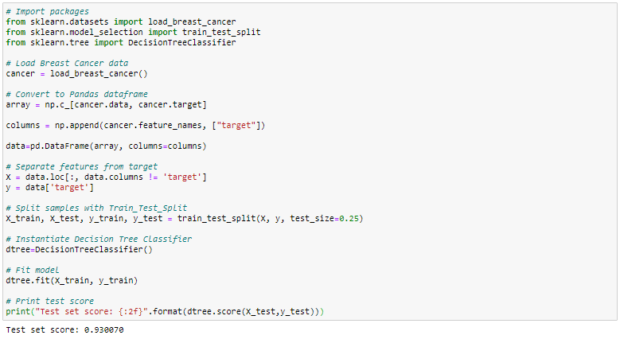
Sci-Kit Learn: Your First Estimator
MACHINE LEARNING IN PYTHON
Look at the code below creating and scoring our first estimator. Our test score looks great, but is that all there is to it? Is this model ready to be used in production?
Notes:
Tags: text, chevron, list, customer experience, CX

Slide 23
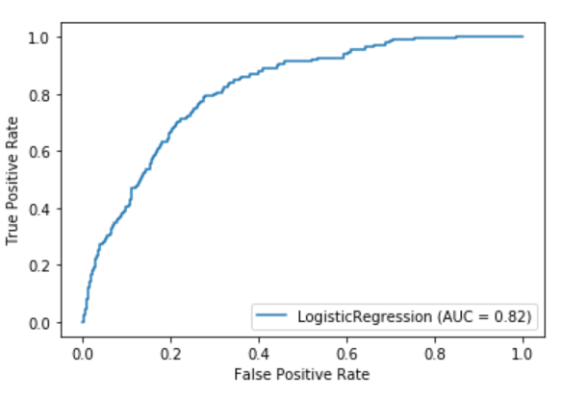
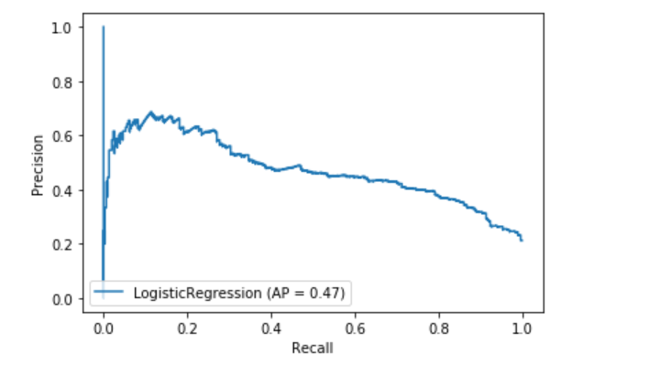
Classification Performance Metrics
CLASSIFICATION
Supervised Machine Learning Classification models are traditionally evaluated based on the correct prediction of a value class for a specific Target/Label as being a True Positive or True Negative associated with the alignment of the Actual and Predicted Values
Performance Measures
Confusion Matrix
Predicted
Y
N
Graphical Evaluation
Actual
True Positive (TP)
The Machine Learning Model Predicted the Actual True Condition of “Y”
False Negative (FN)
The Machine Learning Model Predicted “N” when the actual value was “Y”. Type II Misclassification Error as a False Negative.
Statistical KPIs
Accuracy: Measures the overall fit of the model not accounting for Probability Thresholds (TP+TN)/(TP+TN+FP+FN)
Area Under The Curve (AUC) or ROC: Measures the overall fit of the model based on every decimal range captured within model’s Probability distribution
Precision: measures the fit of the model-based percentage True Positives relative to the total number of predicted Positive cases TP/(TP+FP)
Recall: Measures level sensitivity calculated as the percentage of TP/(TP+FN) to assess model detection
Y
ROC Curve
False Positive (FP)
The Machine Learning Model Predicted “Y” when the actual value was “N”. Type I Misclassification Error as a False Negative. Also referred to a model overfitting
True Negative (TN)
The Machine Learning Model Predicted the Actual True Condition of “N”
Precision
Recall
Curve
N
Notes:
Tags: text, chevron, list, customer experience, CX

